Slide 1
Data Science Workflow Manager Team Member(s): Serge Metellus, Tomas Ortega Product Owner(s): Steven Luis, Dr. Miguel Alonso Professor: Masoud Sadjadi School of Computing and Information Sciences Florida International University
VIP/Senior Project Final Presentation Spring 2019
04/18/2019
Notes:
Greet your audience, thank them for attending your presentation, introduce yourself, introduce your project, introduce your team members, and quickly indicate what each of you did in a high-level manner, and put more emphasis on your part/contribution.

Slide 2

Problem definition
The airline industry currently does not have the capability to fully utilize the large Amounts of data generated every day to enhance customer experience, increase the efficiency of operations or make better data-driven decisions. Following the latest data science tools and techniques, we can leverage valuable insights from airline data
Notes:
Introduce the problem that the whole project tackles and stay focused on the parts that you have been working. Indicate if there is an existing previous system, enumerate its problems/limitations, etc.

Slide 3
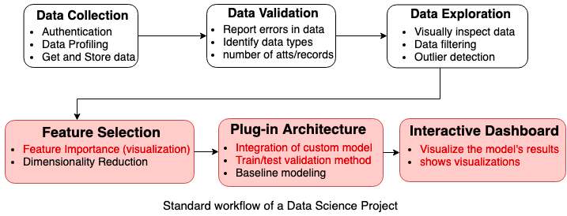
Data Science Workflow
Notes:
Introduce the problem that the whole project tackles and stay focused on the parts that you have been working. Indicate if there is an existing previous system, enumerate its problems/limitations, etc.

Slide 4
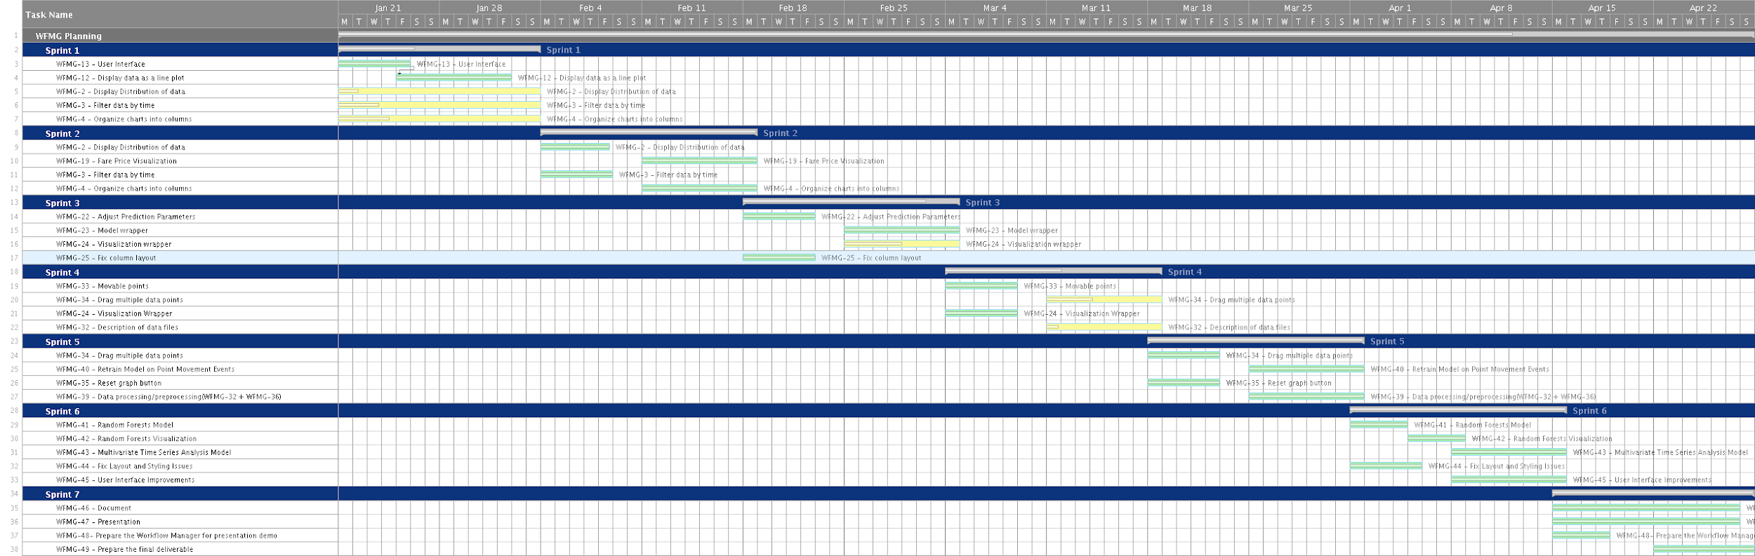
Project Management
Notes:
Project Management (schedule for entire semester) (one slide; Gantt Chart).

Slide 5
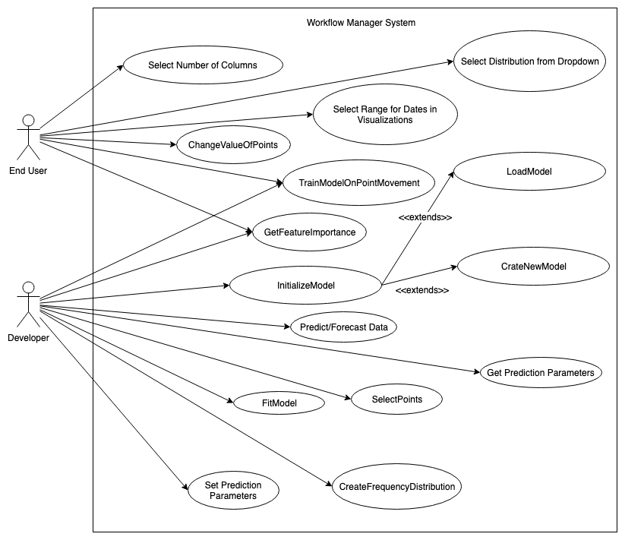
Requirements: Use Case Diagram for The System
Notes:
4. Requirements:
4.1. User stories implemented (one or more slides).
4.2. UML use cases and the use case diagram for the implemented use cases (one or more slides).
4.3. UML sequence diagrams for the implemented use cases.

Slide 6
Requirements: User Stories
(refer to the documentation for full list)
We decided to split the user stories into epics. Here are some of the most important user stories of each epic that we worked on during the semester:
User Interface:
WFMG-2 - Display Distribution of Data
WFMG-3 - Filter Data by time
WFMG-4 - Organize charts into columns
WFMG-33 - Movable Points
Implement an architecture for custom plug-ins:
WFMG-23 - Model Wrapper
WFMG-24 - Visualization Wrapper
Data Cleaning/ Data Validation:
WFMG-8 - Data Processing/Preprocessing
Notes:
4. Requirements:
4.1. User stories implemented (one or more slides).
4.2. UML use cases and the use case diagram for the implemented use cases (one or more slides).
4.3. UML sequence diagrams for the implemented use cases.

Slide 7
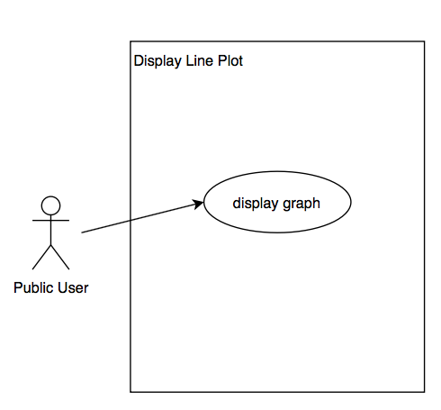
User Stories:
Display Distribution of Data
Description: As an End user, I should be able to map available data sets and display them in the form of line plots to be able to understand trends.
Acceptance Criteria:
It must be integrated with the rest of the webpage.
The visualization must be of appropriate size.
It must work with a large data set.
Charts must be of high quality and ready to publish.
Notes:
4. Requirements:
4.1. User stories implemented (one or more slides).
4.2. UML use cases and the use case diagram for the implemented use cases (one or more slides).
4.3. UML sequence diagrams for the implemented use cases.

Slide 8
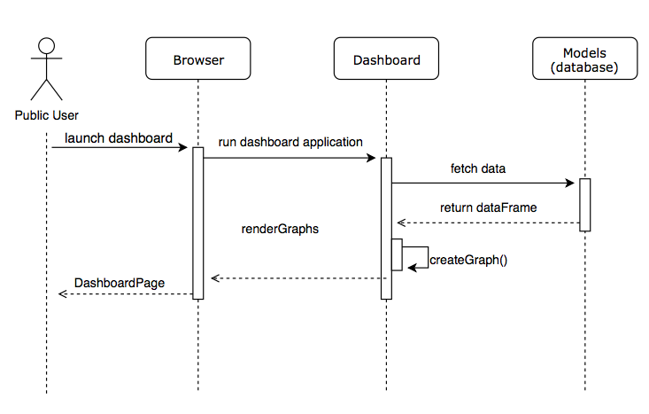
User Stories:
Display Distribution of Data
Description: As an End user, I should be able to map available data sets and display them in the form of line plots to be able to understand trends.
Notes:
4. Requirements:
4.1. User stories implemented (one or more slides).
4.2. UML use cases and the use case diagram for the implemented use cases (one or more slides).
4.3. UML sequence diagrams for the implemented use cases.

Slide 9
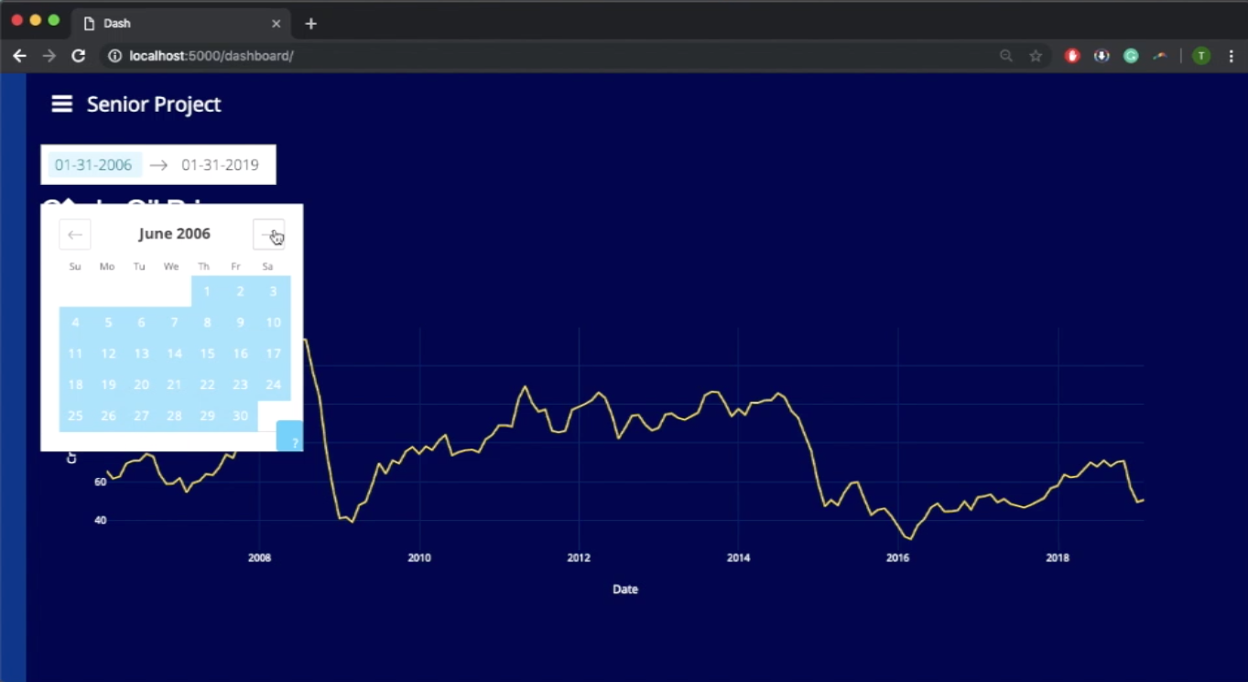
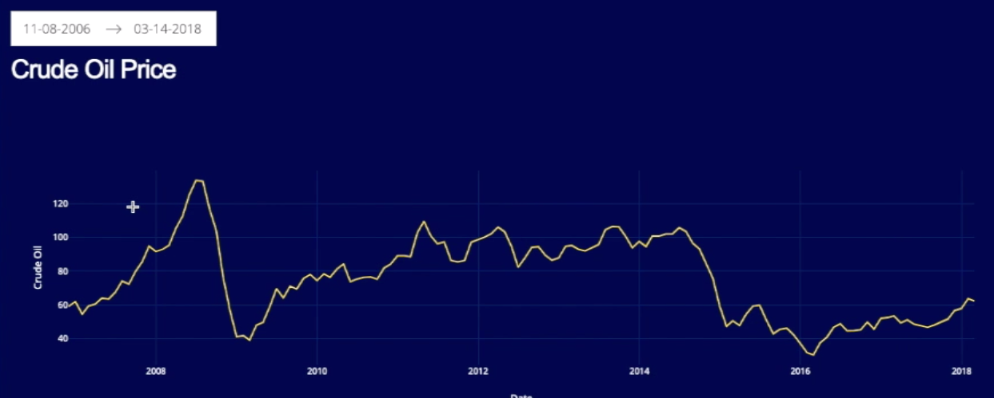
User Stories: Filter Data by time
Description: As a public user, I should be able to filter time series graphs individually according to time.
Acceptance Criteria:
User Interface should be clean and organized.
Must work for the specified attribute.
The filtering should be done quickly and preferably in the backend.
Notes:
4. Requirements:
4.1. User stories implemented (one or more slides).
4.2. UML use cases and the use case diagram for the implemented use cases (one or more slides).
4.3. UML sequence diagrams for the implemented use cases.

Slide 10
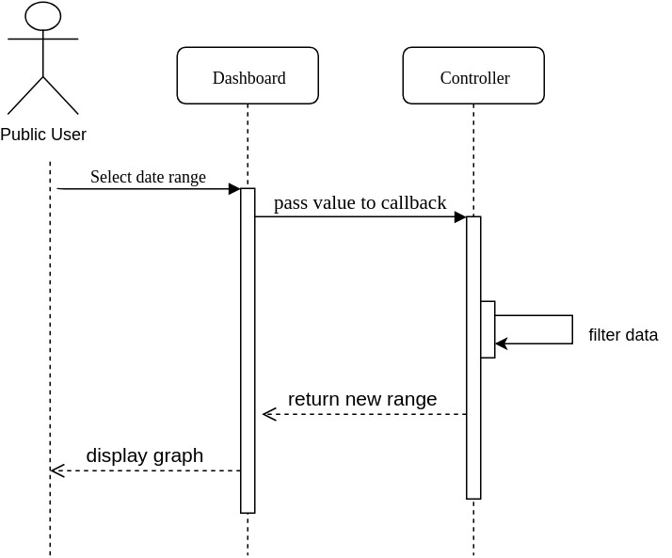
User Stories: Filter Data by time
Description: As a public user, I should be able to filter time series graphs individually according to time.
Notes:
4. Requirements:
4.1. User stories implemented (one or more slides).
4.2. UML use cases and the use case diagram for the implemented use cases (one or more slides).
4.3. UML sequence diagrams for the implemented use cases.

Slide 11
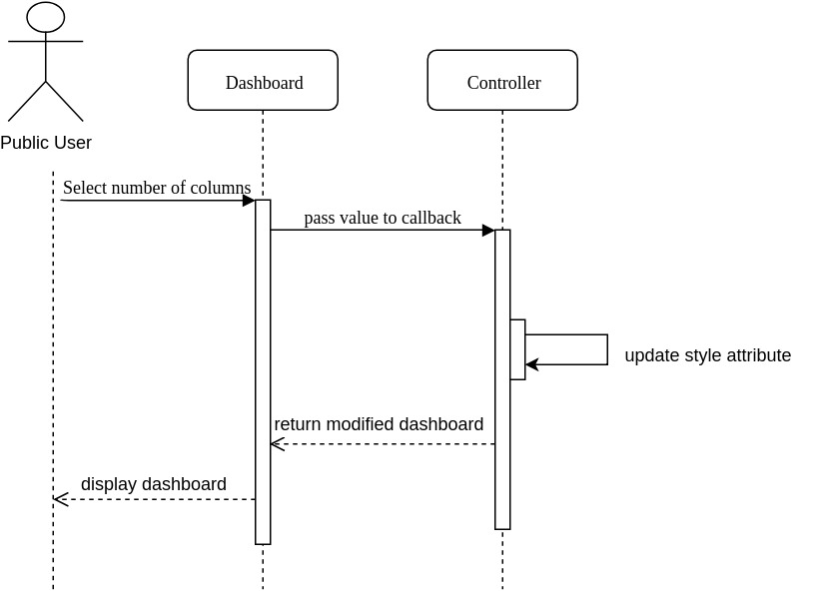
User Stories: Organize charts into columns
Description: As a public user, I must be able to see the data sets in 1, 2, 3, or n columns so that I can identify trends and relationships between the charts.
Acceptance Criteria:
The user must be able to adjust the number of graphs per column.
The user must be able to select the graphs in each column.
It must work with a large data set.
Charts must be of high quality and ready to publish.
The max amount of columns should be restricted to 5 columns.
Notes:
4. Requirements:
4.1. User stories implemented (one or more slides).
4.2. UML use cases and the use case diagram for the implemented use cases (one or more slides).
4.3. UML sequence diagrams for the implemented use cases.

Slide 12
User Stories: Movable Points
Description: As an End User, I would like to be able to move individual data points and trigger an event to redraw the graph with the modified data so that I can visualize the modified data set and later train the model with the modified data.
Acceptance Criteria:
Dragging and Dropping points on the graph should update the data in the server and redraw the graph in the user interface.
The graph should respond quickly to the changes made by the user.
The software should recognize the position of the new point when they are dropped or placed in a new position.
It must be integrated with the rest of the components of the graph (such as the range slider).
Notes:
4. Requirements:
4.1. User stories implemented (one or more slides).
4.2. UML use cases and the use case diagram for the implemented use cases (one or more slides).
4.3. UML sequence diagrams for the implemented use cases.

Slide 13
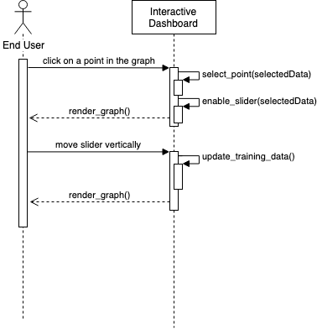
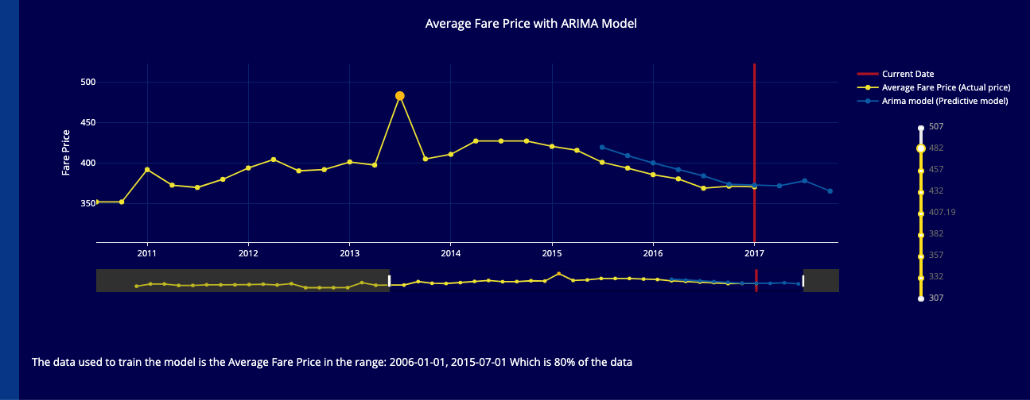
User Stories: Movable Points
Description: As an End User, I would like to be able to move individual data points and trigger an event to redraw the graph with the modified data so that I can visualize the modified data set and later train the model with the modified data.
Notes:
4. Requirements:
4.1. User stories implemented (one or more slides).
4.2. UML use cases and the use case diagram for the implemented use cases (one or more slides).
4.3. UML sequence diagrams for the implemented use cases.

Slide 14
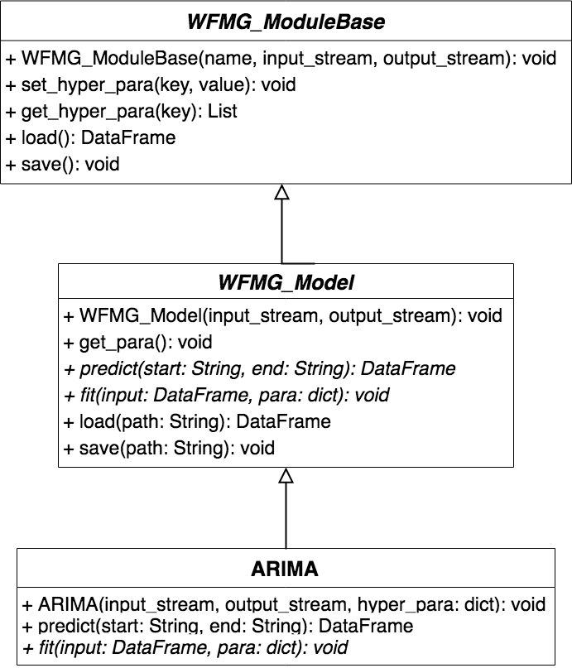
User Stories: Model wrapper
Description: As a model/plug-in developer, I should be able to derive a model from the base class so that a public user can visualize the results of the model and evaluate the results. The model objects should have the following functionalities: saving and loading models from pickles.
Acceptance Criteria:
It must have functions for getting the data for the visualizations.
It must have functions for running the model with new parameters.
It must provide an interface for creating different kinds of models (univariate and multivariate)
Notes:
4. Requirements:
4.1. User stories implemented (one or more slides).
4.2. UML use cases and the use case diagram for the implemented use cases (one or more slides).
4.3. UML sequence diagrams for the implemented use cases.

Slide 15
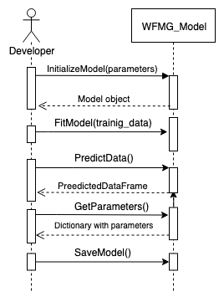
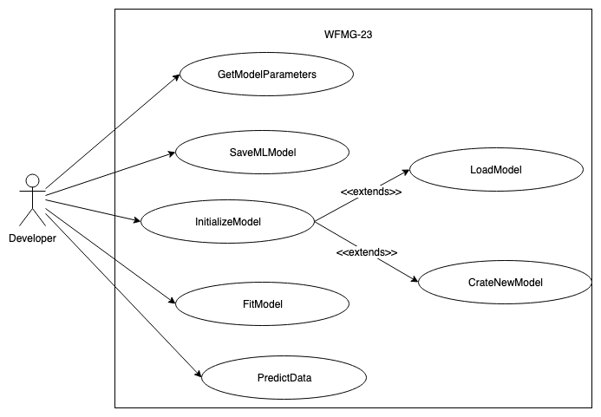
User Stories: Model wrapper
Notes:
4. Requirements:
4.1. User stories implemented (one or more slides).
4.2. UML use cases and the use case diagram for the implemented use cases (one or more slides).
4.3. UML sequence diagrams for the implemented use cases.

Slide 16
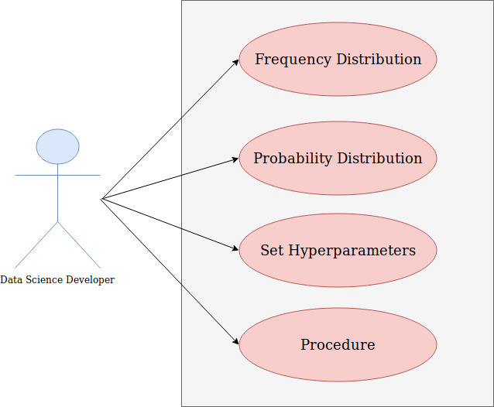
User Stories: Visualization Wrapper
Description: As a model developer, I should be able to derive a procedure class from the base class so that a public user can visualize the results of different data distributions.
Acceptance Criteria:
It must be implemented using object-oriented programming.
It must have functions for getting the data for the visualizations.
Notes:
4. Requirements:
4.1. User stories implemented (one or more slides).
4.2. UML use cases and the use case diagram for the implemented use cases (one or more slides).
4.3. UML sequence diagrams for the implemented use cases.

Slide 17
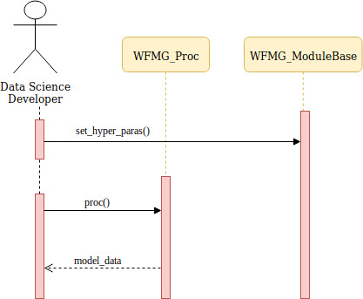
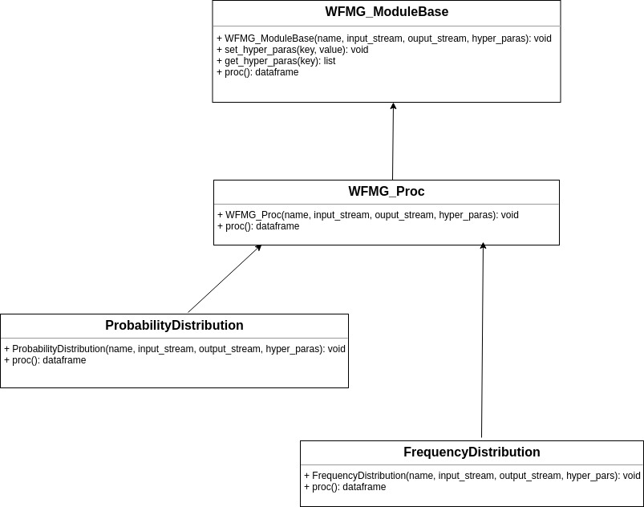
User Stories: Visualization Wrapper
Notes:
4. Requirements:
4.1. User stories implemented (one or more slides).
4.2. UML use cases and the use case diagram for the implemented use cases (one or more slides).
4.3. UML sequence diagrams for the implemented use cases.

Slide 18
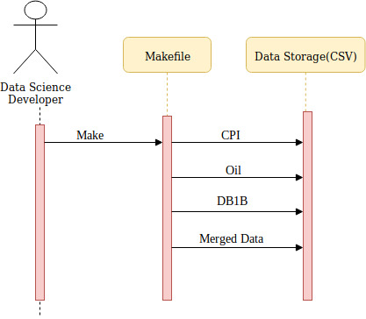
User Stories: Data Processing/Preprocessing
Description: As a developer, I would like the web application to automatically clean and process raw data and store it in a separate directory so that the models can use it as training data or in some procedures.
(Description of data + Processing steps) The team discussed the possibility of using the make utility (a makefile) to specify the cleaning and processing scripts and the order of execution.
Notes:
4. Requirements:
4.1. User stories implemented (one or more slides).
4.2. UML use cases and the use case diagram for the implemented use cases (one or more slides).
4.3. UML sequence diagrams for the implemented use cases.

Slide 19
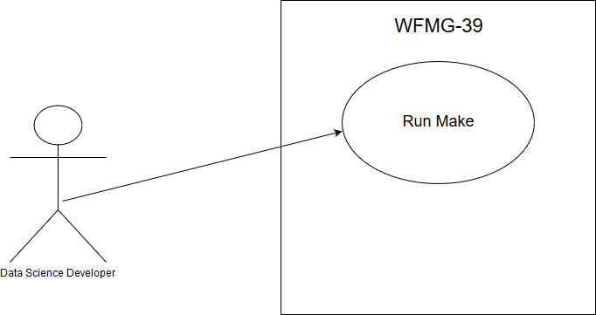
User Stories: Data Processing/Preprocessing

Slide 20
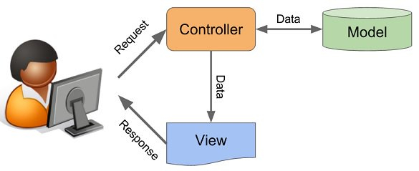
System Design: Architecture
The system was designed using the Model, View, Controller (MVC) Architecture.
The Model component corresponds to all the data-related logic that the user works with. All data used in the visualizations are either processed in the model or processed elsewhere and imported in the model.
The View component is used for all the UI logic of the application. It allows the end users to see the visualizations of the models and different data distributions.
Controllers act as an interface between Model and View components to process all the logic and incoming requests, manipulate data using the Model component and interact with the Views to render the final output.
Notes:
5. System design:
5.1. System decomposition; identify the architecture patterns used (one slide).
5.2. System deployment – h/w and s/w requirements (one slide).
5.3. Persistent data design (one slide).
5.4. Security/Privacy (one slide).

Slide 21
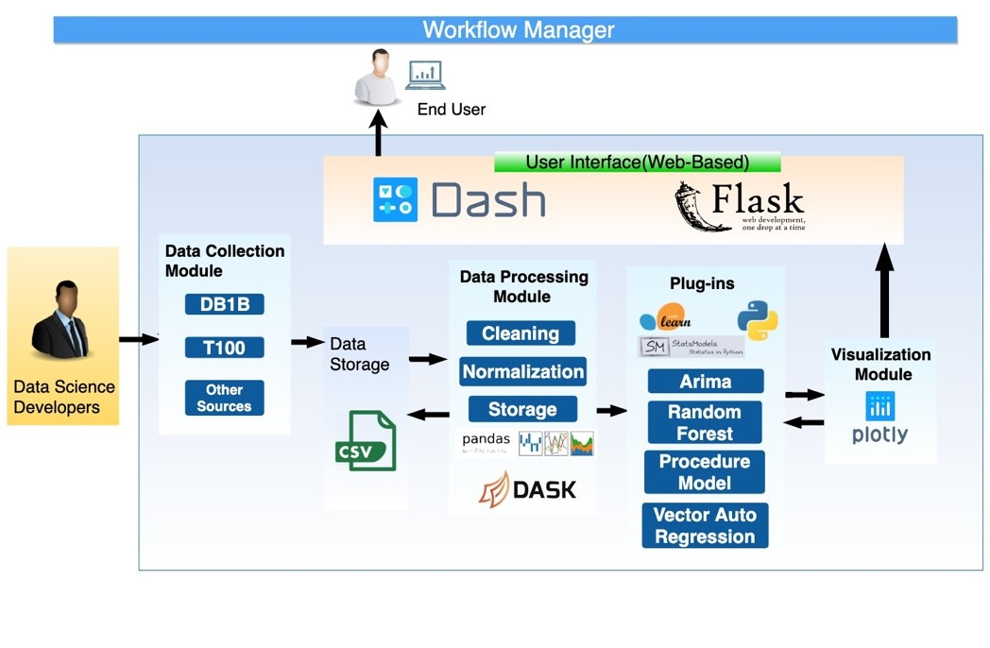
System Design: Architecture
Architecture diagram for the system:
Notes:
5. System design:
5.1. System decomposition; identify the architecture patterns used (one slide).
5.2. System deployment – h/w and s/w requirements (one slide).
5.3. Persistent data design (one slide).
5.4. Security/Privacy (one slide).

Slide 22
Implementation and Technologies Used during development
The following is a list of all hardware and software resources that were used in this project:
Visual Studio 2017 Enterprise - as the IDE
Flask - as a micro web framework.
Dash - as the user interface. Dash uses react and plotly.js to manage the interface using python.
Plotly - as the framework for visualizations (line plots, bar plots, etc…)
Heroku, gunicorn - as the deployment platform.
Redis, flask-caching - as a cache to store the result of computations that require a significant amount of time. Also, can be used to maintain a shared part of memory between threads (and between callbacks)
Bitbucket/Jira – for agile project management.
SciPy (pandas, numpy, scikit-learn) and Dask - as an ecosystem to process csv files and create the plug-in architecture for machine learning models.
Notes:
5. System design:
5.1. System decomposition; identify the architecture patterns used (one slide).
5.2. System deployment – h/w and s/w requirements (one slide).
5.3. Persistent data design (one slide).
5.4. Security/Privacy (one slide).

Slide 23
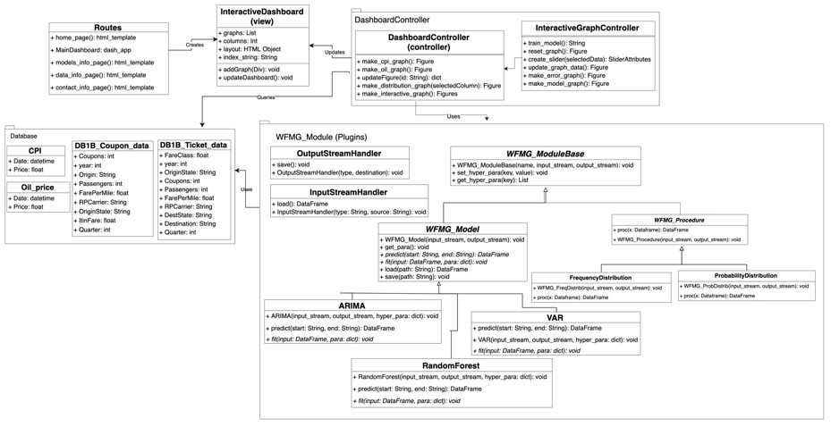
Minimal Class Diagram
Notes:
6. Detailed design:
6.1. Minimal class diagram. Identify the design patterns used (one or more slides).
6.2. State machine for the main control object or the most important object of the implemented uses cases (one or more slides).
6.3. Main algorithm used related to an implemented use case described above (one or more slides).

Slide 24
Test Suites and Test Cases
Most of the testing was done manually, but a small portion was automated using selenium to load and interact with the html in the page.
During development, we used both unit and integration tests to ensure that the user stories are going to perfor as expected during the deployment phase.
Notes:
7. Test Suites and Test Cases (one sunny day and one rainy day) for the use case represented in part (5) above (2 slides).
7.1 One sunny day and one rainy day for the implemented use cases (one or more slides).
7.2 Automated test scripts for the implemented use cases (one or more slides).

Slide 25
Unit Tests: Display Distribution of Data
Test case ID: WFMG-2-UT
Description/Summary of Test: Validate that the user is able to select different graphs for data distributions such as state of departure distributions and fare class distributions. The test was performed specifically with the following graphs: Coupon Distribution, Fare Class Distribution, State of Departure Distribution, Market Share Distribution.
Pre-condition: The application must be running, and the data must be present in the server. In particular, the data must be in the folder under the directory /Data so that the view module can access the data for visualizations.
Expected Results: The user should be able to see the graph for the specified data distribution in the dashboard inside of the Workflow Manager application.
Actual Result: The results are as expected, the application opens with the default graph and changes with the user input.
Status (Fail/Pass): Pass
Notes:
7. Test Suites and Test Cases (one sunny day and one rainy day) for the use case represented in part (5) above (2 slides).
7.1 One sunny day and one rainy day for the implemented use cases (one or more slides).
7.2 Automated test scripts for the implemented use cases (one or more slides).

Slide 26
Unit Tests: Filter data by time
Test case ID: WFMG-3-UT
Description/Summary of Test: Validate that the user is able to select dates from the calendars and the graph updates using those dates
Pre-condition: The user must be in the dashboard page
Expected Results: The user should be able to see the graph for the specified date range.
Actual Result: The results are as expected, the application opens with the default graph and changes with the user input.
Status (Fail/Pass): Pass
Notes:
7. Test Suites and Test Cases (one sunny day and one rainy day) for the use case represented in part (5) above (2 slides).
7.1 One sunny day and one rainy day for the implemented use cases (one or more slides).
7.2 Automated test scripts for the implemented use cases (one or more slides).

Slide 27
Unit Tests: Filter data by time
Test case ID: WFMG-4-UT
Description/Summary of Test: Validate that the user is able to select the number of columns and the dashboard should be displayed with those columns
Pre-condition: The user must be in the dashboard page
Expected Results: The user should be able to see the dashboard and graphs divided into the specified number of columns
Actual Result: The results are as expected when the number of graphs is divisible by the number of columns, other wise the graphs break to accommodate column space
Status (Fail/Pass): Fail
Notes:
7. Test Suites and Test Cases (one sunny day and one rainy day) for the use case represented in part (5) above (2 slides).
7.1 One sunny day and one rainy day for the implemented use cases (one or more slides).
7.2 Automated test scripts for the implemented use cases (one or more slides).

Slide 28
Unit Tests: Model wrapper
Test case ID: WFMG-23-UT
Description/Summary of Test: Validate that the plug-in/model developer is able to create models and use the specified methods on model objects.
Pre-condition: The plug-in/model developer must have the wfmg module in the present working directory or imported from somewhere else and he should be using python 3.6 or higher.
Expected Results: The private user should be able to create new models by inheriting from the WFMG_Model class and use the method from that class to load, save, fit and predict data from the model.
Actual Result: The results are as expected, the models that inherit from the class WFMG_Model are able to use the methods from that class and they return the correct results.
Status (Fail/Pass): Pass
Notes:
7. Test Suites and Test Cases (one sunny day and one rainy day) for the use case represented in part (5) above (2 slides).
7.1 One sunny day and one rainy day for the implemented use cases (one or more slides).
7.2 Automated test scripts for the implemented use cases (one or more slides).

Slide 29
Unit Tests: Visualization Wrapper
Test case ID: WFMG-24-UT
Description/Summary of Test: Validate that the developer is able to instantiate the distribution classes and use the specified methods.
Pre-condition: The developer must have the WFMG module in the present working directory or imported from somewhere else.
Expected Results: The developer should be able to instantiate the Probability and Frequency sub classes.
Actual Result: The results are as expected, the models used to instantiate the distribution sub classes are able to use the methods from those classes and the inherited methods from the superclass.
Status (Fail/Pass): Pass
Notes:
7. Test Suites and Test Cases (one sunny day and one rainy day) for the use case represented in part (5) above (2 slides).
7.1 One sunny day and one rainy day for the implemented use cases (one or more slides).
7.2 Automated test scripts for the implemented use cases (one or more slides).

Slide 30
Unit Tests: Data Processing/Preprocessing
Test case ID: WFMG-39-UT
Description/Summary of Test: Validate that the developers are able to process raw data
Pre-condition: Each data source must have its own directory and python script that specifies the processing steps
Expected Results: The developer should be able to use Make to specify the scripts and order of execution
Actual Result: The results are as expected, the makefile successfully runs the scripts that process the data and store it in a separate directory.
Status (Fail/Pass): Pass
Notes:
7. Test Suites and Test Cases (one sunny day and one rainy day) for the use case represented in part (5) above (2 slides).
7.1 One sunny day and one rainy day for the implemented use cases (one or more slides).
7.2 Automated test scripts for the implemented use cases (one or more slides).

Slide 31
Summary
The goal of this project is to create a workflow manager that allows developers working on a data science project to introduce new models as plugins into data processing to allow end users to visualize and explore processed data and various data distributions. In this first iteration, we focused on the plugin architecture and the interactive dashboard for users interested in analyzing the different data distributions
Serge Metellus smete008@fiu.edu
Tomas Ortega torte007@fiu.edu
Notes:
Summarize your contribution
Include your contact information
Ask if anyone has any questions for you.
Thank your audience

